Slide 2
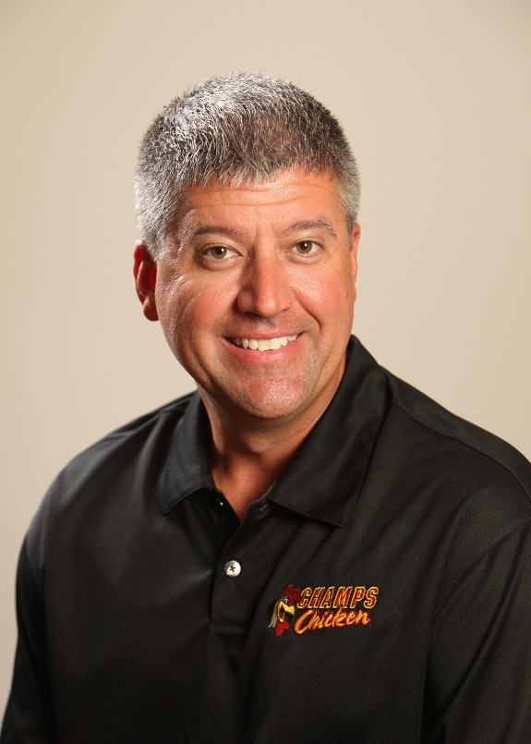
Doing Foodservice Right
We are not in the FOOD business serving People. We are in the PEOPLE business serving food.
Shawn Burcham
Founder & CEO
www.shawnburcham.com
linkedin.com/in/shawnburcham
facebook.com/ShawnBurchamPFS
@ShawnBurcham1

Slide 3
Its What I know…
I’ve been in the Food & Distribution Industry my entire life
Mid-America Dairymen
Chester Fried Distributor (now Chester’s)
PFSbrands
Direct Store Delivery
Distribution Facility
Over the Road Fleet
Food Manufacturing
Notes:
Mid-America Dairymen – Spent 5 years with a Fortune 100 company seeing how BRANDED “food should be run”
Worked for Chester’s Fried as a Distributor
Started PFS 20 years ago with food distribution – Branded programs Direct Store Delivery, to OTR & Fleet, transitioned to full distribution model, food manufacturing

Slide 4
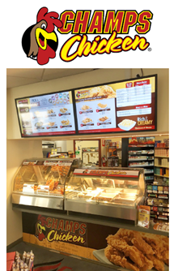
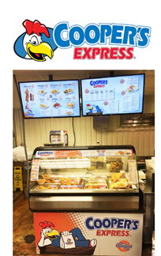
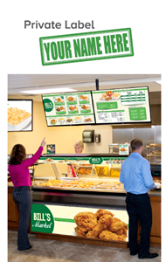
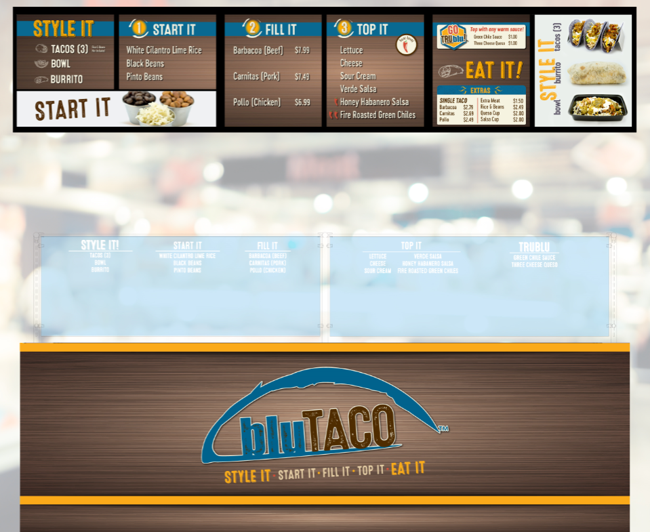
GRITT Business Coaching

Slide 5
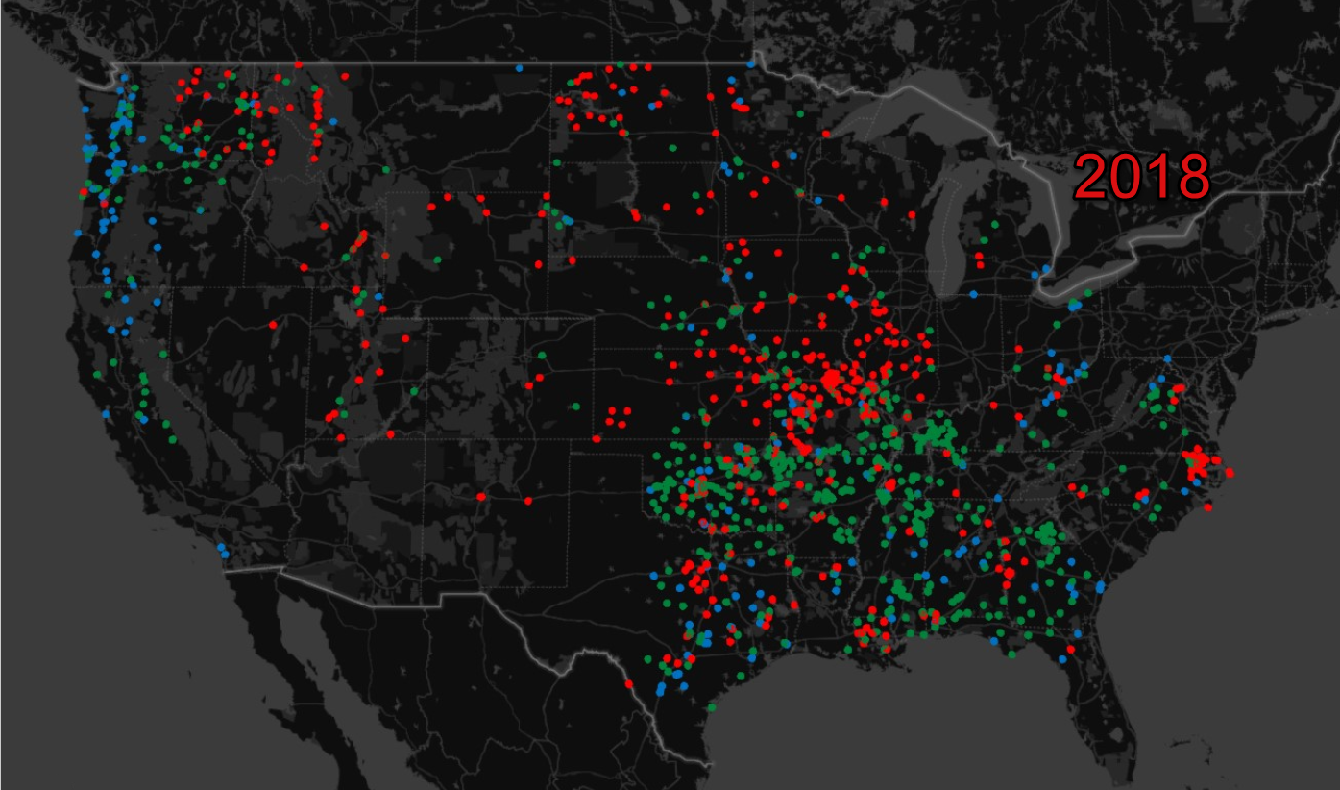

Slide 7
Accomplishments:
All-Star Nominee
2017 & 2018

Slide 9
Core Purpose
To help others become more successful in work & in life.

Slide 10
If asked, can everyone in your organization state your core purpose?
Yes or No

Slide 11
Challenges…
What are your biggest challenges with foodservice?

Slide 12
PEPPER
How to be successful in the foodservice business…

Slide 13
People
Find committed partners that will fully support fresh food
Work to hire the right people in the right places
Commit to learning from those who know what it takes to be successful
First find the right WHO and then do WHAT
First WHO, then WHAT
People

Slide 14
People

Slide 15
Equipment
The right equipment in any foodservice environment is critical, especially a fresh chicken program
Automatic lift fryer
Automatic sifting breading table
Hot case
Rethermalizer
Kiosk
People
Equipment

Slide 16
Products
People
Equipment
Products
The right products take years to develop. Products must be high quality and consistent.

Slide 17
Processes
People
Equipment
Products
Processes
Standard Operation Procedures (SOP) for daily, weekly, monthly, and annual tasks must be in place.

Slide 18
Execution
People
Equipment
Products
Processes
Execution
Pre-opening planning, project management & training are crucial
Regular store visits are critical to ensure any foodservice program is executed properly
The hardest part of any endeavor is executing properly
Notes:
I will show an example of this later (Value Report)

Slide 19
Resources
To be successful partner with a company dedicated to service!
Business Advisors
Business Developers
Store Design/Layout
Project Management
Marketing Team
Print Shop
Customer Success Team
Equipment Division
HR Team
Technology Team
People
Equipment
Products
Processes
Execution
Resources

Slide 20
How many people do you have strictly dedicated to foodservice?
0
1
2-3
4-10
> 10

Slide 21
Director of Foodservice
Manager Foodservice Business Development
Business Developer
Business Developer
Manager Field Operations
Field Operations Advisor
Field Operations Advisor
Business Developer
Field Operations Advisor
Dedicated Team
Notes:
General sales force not being able to handle foodservice. I’ve yet to see a wholesaler show significant success without a foodservice team

Slide 22
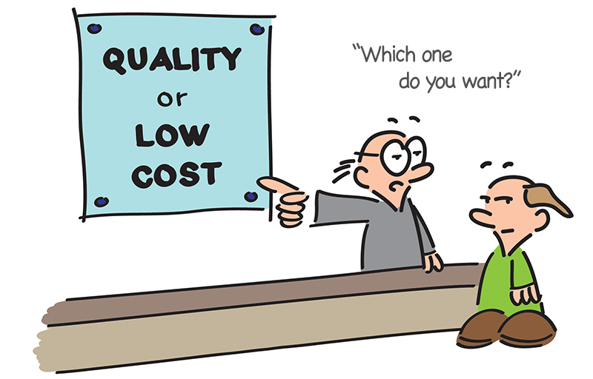
Don’t Get Stuck in
the Middle
Notes:
Quality vs. low cost. Quality & Service vs. Low Cost
Branded programs vs. simply selling foodservice ‘products’. A strong BRAND will always drive more volume for the wholesaler and the retailer.

Slide 23
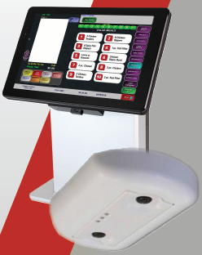
Technology
PFSnet
People Counter
Communication Tablet
Order Management System
Notes:
Hit on Data – The importance of having the RIGHT DATA in foodservice. So many retailers insist on using their same POS system but reasons why it is not the best approach for the retailer. “Technomics”

Slide 24
Real World Example
MONTH 1
Increased price on Top 5 Sellers $.10 - $.20 generating an additional $1,200 in sales and adding 2-3% on Gross Profit
MONTH 2
Increased top 2 selling snacks $.40 for additional $800 in revenue. Targeted Waste Management ensuring less than 5%
MONTH 3
Continue focus on inventory and par level ordering. Utilize traffic count and store sales for staff requirements, and store hours.
MONTH 4
Evaluated bottom 10 sellers and removed slow movers reducing waste. Continued to monitor inventory, sales and waste.
42% GP
46% GP
52% GP
53% GP
Notes:
Hit on Data – The importance of having the RIGHT DATA in foodservice. So many retailers insist on using their same POS system but reasons why it is not the best approach for the retailer. “Technomics”

Slide 25
Foodservice
Gross Margin
Notes:
Emphasize the gross margin opportunity available for retailers and the additional item sales that foodservice drives in c-stores
One of, if not the largest gross margin opportunity. C-Store is shrinking

Slide 26
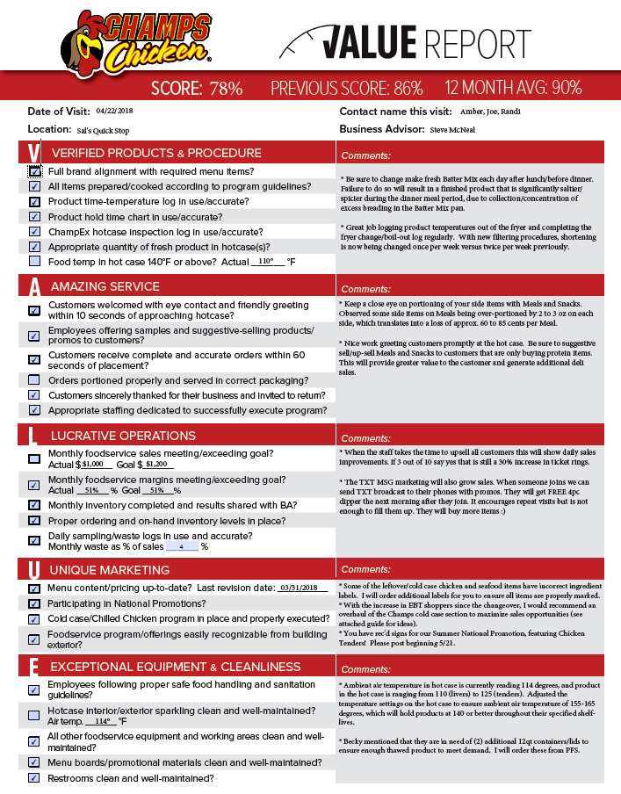
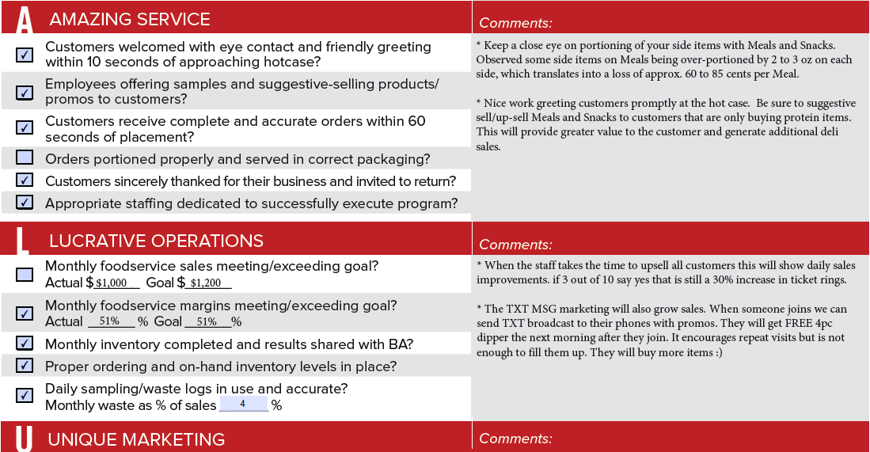
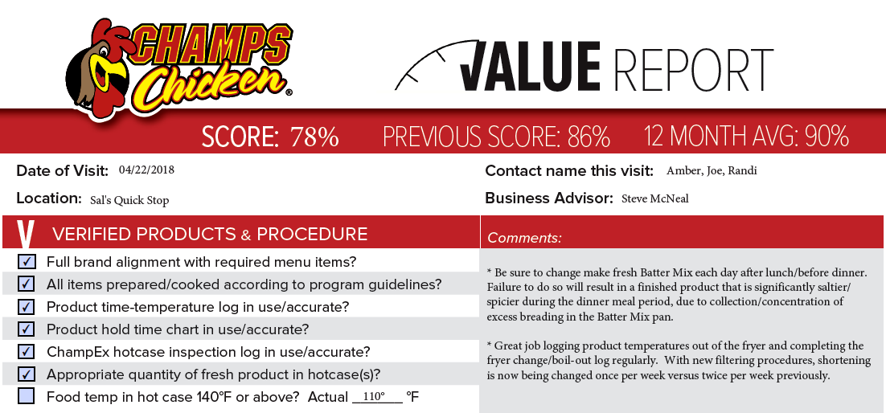
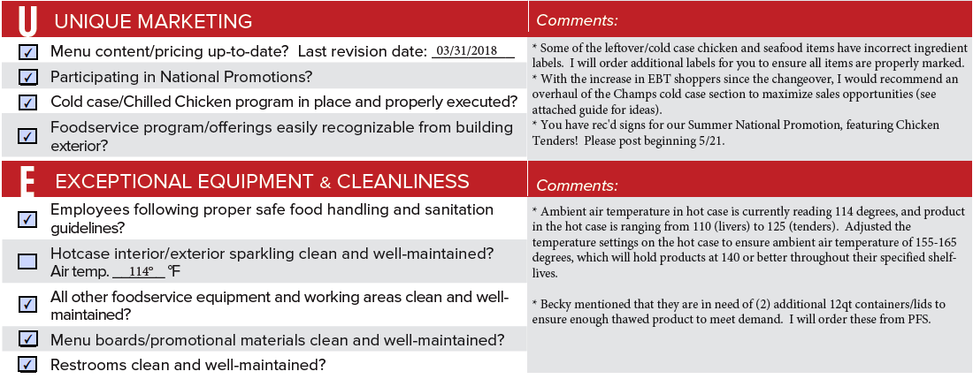
Systems & Processes
Notes:
An outside firm that controls a BRAND can be ‘the bad guy’ and mitigate conflict between you and the customer

Slide 27
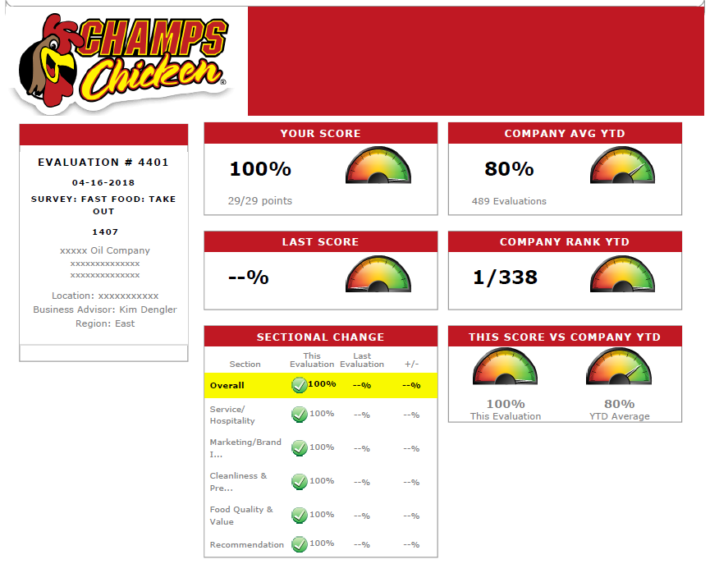
Execution
Secret Shopper

Slide 28
Text Loyalty Programs
Why Opt for SMS/Text & Loyalty Program?
Consumers generally prefer receiving coupons via SMS/Text. This has become the notification platform of choice for Business-to-Consumer (B2C) communications.
Lower investment than traditional paper couponing
Easy mobile redemption for both retailer & consumer
Higher coupon redemption rates
Consumer convenience
Tracking ability

Slide 29
Culture

Slide 30
Key Takeaways
& Acton Items
Be COMMITTED and work with supplier partners that are COMMITTED!
Know your WHY!
Seek out PROGRAMS that drive significant volume while offering CONSISTENT pricing and quality!
Find partners that have their Sales & Operation TEAMS SEPERATE! Do the same with your foodservice team!
Hire the RIGHT PEOPLE – First WHO then WHAT!
Select the right EQUIPMENT!
PROCESSES, PROCESSES, PROCESSES! Standard Operating Procedures are critical.
Develop ways to help your retailers EXECUTE!
Select supplier partners that have the RESOURCES to help you and your retailers be successful in foodservice.
Don’t get stuck in the middle! Is your company focusing on QUALITY & SERVICE or LOW COST!
Emphasize the POWER OF TECHNOLOGY to your retailers!
FOLLOW UP, FOLLOW UP, FOLLOW UP! – What value do you & your foodservice partners consistently bring to your retailers?

Slide 31
Q & A
Shawn Burcham
Shawn.Burcham@pfsbrands.com
Lori.Kimbrough@pfsbrands.com
Founder & CEO
www.shawnburcham.com
linkedin.com/in/shawnburcham
facebook.com/ShawnBurchamPFS
@ShawnBurcham1

